Slide 1

Cohort study

Slide 2
Elements
Selection of study subjects
Obtaining data on exposure
Selection of comparison groups
Follow-up
Analysis.

Slide 3
Selection of study subjects
General population
Exposure or cause of death is fairly frequent in the population
Residing in well defined geographical, political and administrative areas
If the population is very large, an appropriate sample is taken.
The exposed and unexposed segments of the population to be studied should be representative of the corresponding segments of the general population.

Slide 4
Selection of study subjects (Special groups)
Select group
These may be professional groups (e.g., doctors, nurses, lawyers, teachers, civil servants), insured persons, obstetric population, college alumni, government employees, volunteers, etc.
Doll’s prospective study on smoking and lung cancer was carried out on British doctors listed in the Medical Register of the UK in 1951.
These groups are not only homogeneous, but they also offer advantages of accessibility and easy follow-up for a protracted period
Exposure groups :
If the exposure is rare, a more economical procedure is to select a cohort of persons known to have experienced the exposure.
A readily accessible source of these groups is workers in industries and those employed in high-risk situations (e.g., radiologists exposed to X-rays).
When cohorts have been selected because of special exposure, it facilitates classification of cohort members according to the degree or duration of exposure to the suspected factor for subsequent analytical study.

Slide 5
Data on exposure
Cohort members : through personal interviews or mailed questionnaires.
Review of records: Certain kinds of information (e.g., dose of radiation, kinds of surgery, or details of medical treatment) can be obtained only from medical records,
Medical examination or special tests : Some types of information can be obtained only by medical examination or special tests, e.g., blood pressure, serum cholesterol, ECG.
Environmental surveys : This is the best source for obtaining information on exposure levels of the suspected factor in the environment where the cohort lived or worked.
Classification of cohort members :
According to whether or not they have been exposed to the suspected factor, and
According to the level or degree of exposure, at least in broad classes, in the case of special exposure groups
Basic information about demographic variables which might affect the frequency of disease under investigation, should also be collected. Such information will be required for subsequent analysis.

Slide 6
Comparison groups
Internal comparison
External comparison
When information on degree of exposure is not available, it is necessary to put up an external control, to evaluate the experience of the exposed group, e.g., a cohort of radiologists compared with a cohort of ophthalmologists, etc.
The study and control cohorts should be similar in demographic and possibly important variables other than those under study.

Slide 7
Comparison groups
Comparison with general population rates
If none is available, the mortality experience of the exposed group is compared with the mortality experience of the general population in the same geographic area as the exposed people
Rates for disease occurrence in sub-groups of the control cohort by age, sex, and other variables considered important may be applied to the corresponding sub-groups of the study cohort (exposed cohort) to determine the “expected” values in the absence of exposure.
The ratio of “observed” and “expected” values provides a measure of the effect of the factor under study.
The limiting factors in using general population rates for comparison are :
(i) non-availability of population rates for the outcome required;
(ii) the difficulties of selecting the study and comparison groups which are representative of the exposed and non-exposed segments of the general population.

Slide 8
Follow up
The procedures required comprise :
Periodic medical examination of each member of the Cohort
Reviewing physician and hospital records
Routine surveillance of death records
Mailed questionnaires, telephone calls, periodic home visits - preferably all three on an annual basis.
Of the above, periodic examination of each member of the cohort, yields greater amount of information on the individuals examined, than would the use of any other procedure.
Certain percentage of losses to follow-up are inevitable due to death, change of residence, migration or withdrawal of occupation. These losses may bias the results. It is, therefore, necessary to build into the study design a system for obtaining basic information on outcome for those who cannot be followed up in detail for the full duration of the study.
The safest course recommended is to achieve as close to a 95 per cent follow-up as possible

Slide 9
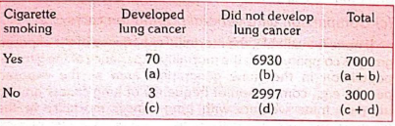
Analysis
Incidence rates of outcome among exposed and non exposed,
Estimation of risk.

Slide 10


Estimation of risk
Relative risk
It is a direct measure (or index) of the “strength” of the association between suspected cause and effect.
It is often useful to consider the 95 per cent confidence interval of a relative risk since it provides an indication of the likely and maximum levels of risk.
Attributable risk aka risk difference
what extent the disease under study can be attributed to the exposure.

Slide 11
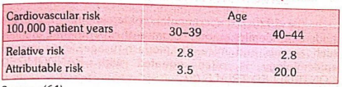
Population attributable risk
Incidence of the disease (or death) in the total population minus the incidence of disease (or death) among those who were not exposed to the suspected causal factor
The concept of population attributable risk is useful in that it provides an estimate of the amount by which the disease could be reduced in that population if the suspected factor was eliminated or modified
Relative risk vs attributable risk

Slide 12
Advantages
Incidence can be calculated,
Several possible outcomes related to exposure can be studied simultaneously
Cohort studies provide a direct estimate of relative risk
Dose response ratios can also be calculated,
Since comparison groups are formed before disease develops, certain forms of bias can be minimized like mis-classification of individuals into exposed and unexposed groups.

Slide 13
Disadvantages
Cohort studies involve a large number of people. They are generally unsuitable for investigating uncommon diseases or diseases with low incidence in the population.
It takes a long time to complete the study and obtain results. It is difficult to keep a large number of individuals under medical surveillance indefinitely.
Certain administrative problems such as loss of experienced staff, loss of funding and extensive record keeping are inevitable
It is not unusual to lose a substantial proportion of the original cohort - they may migrate, lose interest in the study or simply refuse to provide any required information,
Selection of comparison groups which are representative of the exposed and unexposed segments of the population is a limiting factor.
There may be changes in the standard methods or diagnostic criteria of the disease over prolonged follow-up.
Cohort studies are expensive,
The study itself may alter people’s behaviour.
We are faced with ethical problems of varying importance. As evidence accumulates about the implicating factor in the aetiology of disease, we are obliged to intervene and if possible reduce or eliminate this factor
Practical considerations dictate that we must concentrate on a limited number or factors possibly related to disease outcome.

Slide 14
Bias
Selection bias
Information bias
Confusion bias

Slide 15
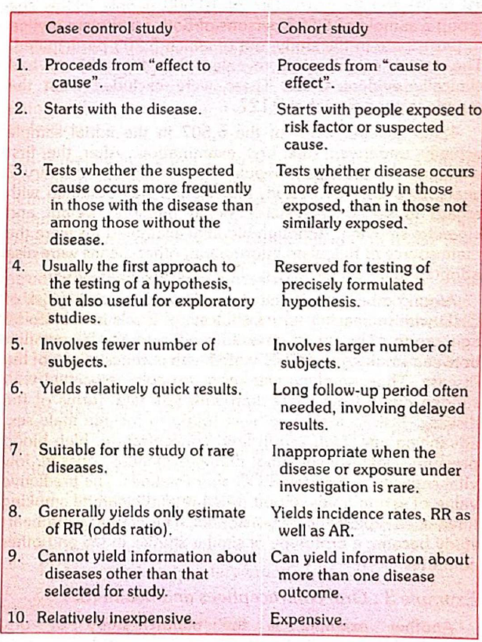

Slide 16

Thanks

